Slide 1


DATA VISUALIZATION INTERVIEW QUESTIONS
PRESENTED BY-K.SHALINI

Slide 2
What is data visualization and why is it used?

Slide 3
Data visualization is the practice of translating information into a visual context, such as a map or graph, to make data easier for the human brain to understand and pull insights from.
The main goal of data visualization is to make it easier to identify patterns, trends and outliers in large data sets.

Slide 4
Name any 5 data visualization Tool

Slide 5
Tableau
Qlik view
Power BI
Plotly
Excel
Sisense
Google sheets
Raw
Zoho analytics

Slide 6
What kind of software is Tableau?

Slide 7
Tableau is the powerful and fastest visualizing tool that is used in the Business Intelligence(BI) Industry.
It simplifies the raw data into an understandable format. Analysis of the data becomes faster with Tableau.
The visualizations can be created in the form of dashboards.
The visualizations or diagrammatic representation of data can easily be understood by the employees of the organizations who are at different levels.

Slide 8
What are the products offered by Tableau? Explain about it.

Slide 9
Tableau Prep: Tableau Prep is responsible for preparing data for analysis. This tool provides 3 coordinated views which provide us with a complete picture of data.
Tableau Desktop: Tableau Desktop is the place where the analysis happens. It has powerful drag and drops analytics which is very easy to use. Through the desktop, you get your data insights quickly.
Tableau Online: Tableau Online is a secure and scalable self-service analytics cloud tool. You can use it anywhere, anytime and it has eliminated the complexities of IT.
Tableau Server: From small to large enterprises, Tableau server is used for fulfilling their BI requirements. This is an on-premise solution. This tool can take data from anywhere and shared it across the organization through the desktop or mobile browsers.

Slide 10
How many types of data connections are there in Tableau? What are they?

Slide 11
We have 2 types they are live & extract

Slide 12
Is Tableau live or extract better?

Slide 13
Extract are better than live connection because Extracts are optimized for storage and performance. Extracts tend to be much faster than live connections, especially in more complex visualizations with large data sets, filters, calculations A live connection will always have a constraint of upload and download network and internet speeds.

Slide 14
. What are the different datatypes in Tableau?

Slide 15
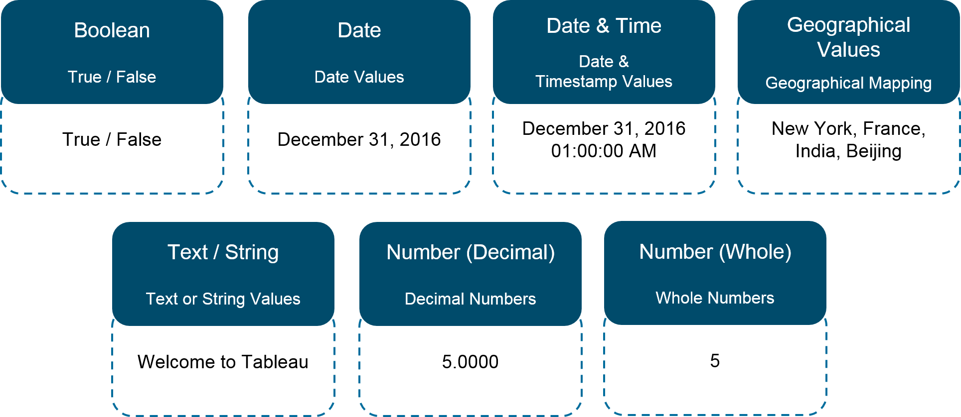
.

Slide 16
What are Measures and Dimensions?

Slide 17
Measures are the numeric metrics or measurable quantities of the data, which can be analyzed by dimension Dimensions are the descriptive attribute values

Slide 18
Explain different connection types in Tableau?

Slide 19
Extract: Extract is a snapshot of data that will be extracted from the data source and put into the Tableau repository. This snapshot can be refreshed periodically fully or incrementally. Live: It creates a direct connection to the data source and data will be fetched directly from tables. So, data will be up to date and consistent. But, this also affects access speed.

Slide 20
What is discrete data in Tableau?

Slide 21
Discrete data roles are values that are counted as distinct and separate and can only take individual values within a range.
Examples: number of threads in a sheet, customer name or row ID or State. Discrete values are shown as blue pills on the shelves and blue icons in the data window.

Slide 22
What is Continuous data in Tableau?

Slide 23
Continuous data roles are used to measure continuous data and can take on any value within a finite or infinite interval.
Examples: unit price, time and profit or order quantity.Continuous values are shown as green pills.

Slide 24
What is the maximum no. of rows Tableau can utilize at one time?

Slide 25
Tableau is not restricted by the no. of rows in the table. Customers use Tableau to access petabytes of data because it only retrieves the rows and columns needed to answer your questions.

Slide 26
What are joins in Tableau?

Slide 27
The join clause tells Tableau which fields are shared between the tables and how to match the corresponding rows. For example, rows with the same ID are aligned in the results table. Join clauses most often use the equality operator (=) which matches rows with the same values.

Slide 28
What is the difference between join and relationship in Tableau?

Slide 29
Relationships are called the Logical layer and Joins are called the physical layer.
Relationships keep the tables separate and do not merge them into a single table.

Slide 30
How many maximum tables can you join in Tableau?

Slide 31
32

Slide 32
Why is blending used in Tableau?

Slide 33
Blending is used when there is related data in multiple data sources, which you want to analyze together in a single view

Slide 34
What is difference between blend and join in Tableau?

Slide 35
Data Blending Aggregates the data and then combines it. Joins combine the data and then aggregates it.
Data Blending can combine data from different sources. Joins can combine data from the same sources only.

Slide 36
What is default Data Blending Join?

Slide 37
Left Join

Slide 38
When is it good to use Join & Union?

Slide 39
"JOIN" is for two data tables that have different structures, while "UNION" is for two data tables that have the same structure.

Slide 40
What is the difference between union and join in Tableau?

Slide 41
You can union your data to combine two or more tables by appending values (rows) from one table to another. To union your data in Tableau data source, the tables must come from the same connection.
Joins combine data into new columns. If two tables are joined together, then the data from the first table is shown in one set of column alongside the second table's column in the same row.

Slide 42
Is Full outer join and UNION same?

Slide 43
No, Union is vertical Full outer join is horizontal.

Slide 44
Explain about shelves

Slide 45
Every worksheet in Tableau contains shelves and cards, such as Columns, Rows, Marks, Filters, Pages, Legends, and more.
By placing fields on shelves or cards, you can Build the structure of your visualization.
Increase the level of detail and control the number of marks in the view by including or excluding data.

Slide 46
What is the most commonly used field in the Pages card

Slide 47
Date field

Slide 48
Explain Difference Between Individual, Dual and Blended Axis?

Slide 49
Individual Axis: when you have only one measure is used in single line graph.
Example: Sales by Year.
Dual Axis: when you have two measures are used in dual lines graphs or charts. One axis represents one measure and other axis represents second measure. Both axis will be parallel to each other with different range of values from the source data. Example: Sales and Profits by Year
Blended Axis: when you have more than two measures are used in multi line charts. Multiple measures can share in a single axis so that all the marks will be shown in a single pane. We can blend measures by dragging the 1st measure on one axis and the 2nd on the existing axis. Example: Sales, Profits and Discounts by Year.

Slide 50
What are reference bands for?

Slide 51
A reference band is the shaded region behind a graph of a continuous measure, and it is useful for highlighting the area falling in that band.

Slide 52
What is a parameter in Tableau?

Slide 53
Parameters in Tableau are dynamic values that you can replace as constant values in calculations. These values serve as context filters.

Slide 54
Why do we use filters in Tableau?

Slide 55
The filtering capability in a BI tool can serve a variety of purposes including minimizing the size of the data for efficiency purposes, cleaning up underlying data, removing irrelevant dimension members, and setting measure or date ranges for what you want to analyze.

Slide 56
What are the different type of filters in Tableau?

Slide 57
Extract Filters.
Data Source Filters.
Context Filters.
Dimension Filters.
Measure Filters.
Table Filters.

Slide 58
What is the difference between filters and parameters in Tableau?

Slide 59
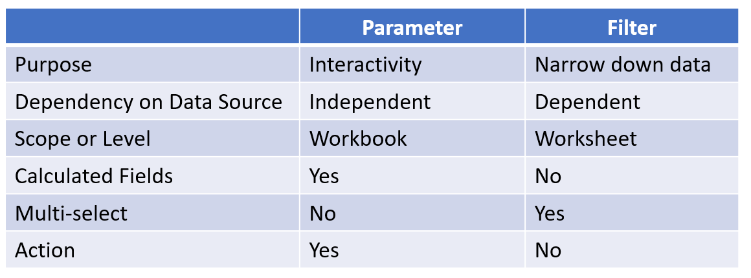

Slide 60
What is a hierarchical field?

Slide 61
A hierarchical field in tableau is used for drilling down data. It means viewing your data in a more granular level.

Slide 62
What is the difference between set and group in Tableau?

Slide 63
Sets are used to form subsets of data, based on the conditions chosen. For example, a set can be created for having a subset data of top 10 customers with the highest sales.
Group is used to combine members present in a field. They let you put together data in a way that makes sense for your particular analysis needs. For example, aggregated values of ‘Furniture’ and ‘Office Supplies’ can be obtained by using group.

Slide 64
How to create a calculated field in Tableau?

Slide 65
Click the drop down to the right of Dimensions on the Data pane and select “Create > Calculated Field” to open the calculation editor.
Name the new field and create a formula.

Slide 66
What is disaggregation and aggregation of data?

Slide 67
The process of viewing numeric values or measures at higher and more summarized levels of the data is called aggregation.
Disaggregating your data allows you to view every row of the data source which can be useful when you are analyzing measures that you may want to use both independently and dependently in the view.
For example, you may be analyzing the results from a product satisfaction survey with the Age of participants along one axis. You can aggregate the Age field to determine the average age of participants or disaggregate the data to determine what age participants were most satisfied with the product.

Slide 68
What is the use of show me in Tableau?

Slide 69
The show me clause is used to applying a required view to existing data in the worksheet.
Views are displayed in graphical formats like a line chart, pie chart, and scatter plot.

Slide 70
Define LOD Expression?

Slide 71
LOD Expression stands for Level of Detail Expression, and it is used to run complex queries involving many dimensions at the data sourcing level.

Slide 72
When can we use bar chart?

Slide 73
You can use bar chart to quickly compare data across categories, highlight differences, show trends and outliers, and reveal historical highs and lows at a glance.
Bar charts are especially effective when you have data that can be split into multiple categories.

Slide 74
When can we use line chart?

Slide 75
Line chart connects several distinct data points, presenting them as one continuous evolution.
Use line charts to view trends in data, usually over time.
The result is a simple, straightforward way to visualize changes in one value relative to another.

Slide 76
When can we use pie chart?

Slide 77
A pie chart represents data as slices of a circle with different sizes and colors.
Pie charts are best to use when you are trying to compare parts of a whole.

Slide 78
Differentiate between Tiled and Floating in dashboards?

Slide 79
In a tiled layout, items don’t overlap. The layout will be adjusted according to dashboard size. In the floating layout, items can be placed on some other layers. Floating items can have fixed positions and sizes.

Slide 80
State the components of the dashboard?

Slide 81
Web: it consists of a web page embedded in the dashboard.
Horizontal component: it is a horizontal layout container in which we can add objects.
Vertical component: it is a vertical layout container in which we can add objects.
Image Extract: it allows you to upload an image to the dashboard from a computer.
Text: it is a small Word pad where we can format and edit the text.

Slide 82
When can we use maps?

Slide 83
If you have geographic information associated with your data, maps are a simple and compelling way to show how location correlates with trends in your data.

Slide 84
When can we use Density maps?

Slide 85
Density maps reveal patterns or relative concentrations that might otherwise be hidden due to an overlapping mark on a map.
Density maps are most effective when working with a data set containing many data points in a small geographic area.

Slide 86
When can we use Scatter plot?

Slide 87
Scatter plots are an effective way to investigate the relationship between different variables.
A scatter plot presents lots of distinct data points on a single chart.
The chart can then be enhanced with analytics like cluster analysis or trend lines.

Slide 88
When can we use Gantt chart?

Slide 89
Gantt charts display a project schedule or show changes in activity over time along with resource allocation.

Slide 90
When can we use Bubble chart?

Slide 91
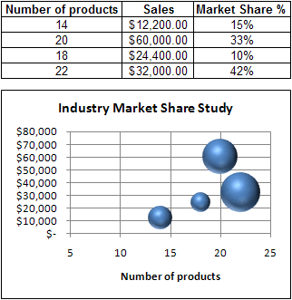
Bubble charts allow us to visualize three different measures at the same time.

Slide 92
When can we use Tree maps?

Slide 93
Tree maps relate different segments of your data to the whole. They make efficient use of space to show percent total for each category.

Slide 94
What is the calculated field in Tableau?

Slide 95
A calculated field is a new field that you can create using a formula to modify the existing field in your data source.

Slide 96
Differentiate between Excel and Tableau?

Slide 97
Excel | Tableau
Excel is spreadsheet software that is used for data manipulation. | Tableau is a data visualization tool that is used for analysis.
It is ideal for statistical analysis of structured data. | It is ideal for the quick and easy representation of big data.
Macro and visual basic language are must to fully utilize excel. | It can be used with no programming experience.
The inbuilt security feature is not as good as compared to Tableau. | The inbuilt security feature is not as good as compared to Excel.
Best for preparing on-off reports with small data | Best while working with big data.

Slide 98
Which option do we use to adjust the text within a cell

Slide 99
Wrap text

Slide 100
What is the use of Name box?

Slide 101
Name Box is located in the left most corner of the Excel sheet. Usually, we use Name box to check the cell reference to the active cell. We can define the name of the range through Name box.

Slide 102
Mention the usage of sheet protection

Slide 103
To prevent other users from accidentally or deliberately changing, moving, or deleting data in a worksheet, you can lock the cells on your Excel worksheet and then protect the sheet with a password.

Slide 104
What is the freeze pane in Excel?

Slide 105
The Excel Freeze Panes option allows you to lock your columns and/or rows so that when you scroll down or over to view the rest of your sheet, the column and/or row will remain on the screen.

Slide 106
What is the difference between function and formula in MS-Excel?

Slide 107
Formula is a statement which is written by the user (user-created) to be calculated. A formula can contain values, cell references, defined names, and functions.
Functions are in-built codes provided in MS-Excel, such as IF, COUNT, SUM, AVERAGE and so on. If additional functions are required we can create them through VBA. They are called user defined functions.

Slide 108
What is the IF function in Microsoft Excel?

Slide 109
‘If function’ is one of the logical functions in Excel. We use this function to check the logical condition and specify the value whether it’s true or false.

Slide 110
What is the SUMIF function in Microsoft Excel?

Slide 111
Sum if function is used to add the cells specified by a given condition or criterion.

Slide 112
What is an IF error function?

Slide 113
The IFERROR function in Excel is designed to trap and manage errors in formulas and calculations.
IFERROR checks a formula, and if it evaluates to an error, returns another value you specify; otherwise, returns the result of the formula.

Slide 114
What is Pivot table and why we use it?

Slide 115
Pivot table allows quick summarizing of large data.
Pivot table gives us flexibility and analytical power
It is a time saver source in Excel
Create a dynamic pivot chart

Slide 116
How can we merge multiple cells text strings in a cell?

Slide 117
We can merge multiple cells text string by using the Concatenate function and “&” function.

Slide 118
Difference between Absolute & Relative Cell Reference?

Slide 119
Relative references change when a formula is copied to another cell.
Absolute references remain constant no matter where they are copied.

Slide 120
Difference between vlookup & hlookup?

Slide 121
VLOOKUP allows you to search a data range that is set up vertically.
HLOOKUP is the exact same function, but looks up data that has been formatted by rows instead of columns.

Slide 122
What is the difference among COUNT, COUNTA, COUNTIF and COUNTBLANK in Ms-Excel?

Slide 123
COUNT is used to count cells containing numbers, dates, etc. any value stored as number excluding blanks.
COUNTA or Count All is used to count any cell value containing numbers, text, logical values, etc. any type of value excluding blanks.
COUNTBLANK count blank cells or cells with an empty string.
COUNTIF and COUNTIFS count cells matching a certain criteria.

Slide 124
What is a Macro in Excel? How to create an Excel Macro?

Slide 125
Excel Macro is the set of instructions that is recorded by users for repetition purposes.

Slide 126
How many rows and columns are there in Microsoft Excel 2003 and later versions?

Slide 127
Excel Versions | Rows | Columns | Total Cells
MS Excel 2003 | 65536 | 256 | 16777216
MS Excel 2007 | 1048576 | 16384 | 17179869184
MS Excel 2010 | 1048576 | 16384 | 17179869184
MS Excel 2013 | 1048576 | 16384 | 17179869184

Slide 128
THANK YOU

